Slide 1

Detecting novel associations in large data sets
Sofiia Denisenko 狄苏菲 1820249051

Slide 2
TASK
Detecting Novel Associations in Large Data Sets,David N. Reshef et al.,Science 334, 1518 (2011);
Identifying interesting relationships between pairs of variables in large data sets is increasingly important. Here, we present a measure of dependence for two-variable relationships: the maximal information coefficient (MIC). MIC captures a wide range of associations both functional and not, and for functional relationships provides a score that roughly equals the coefficient of determination (R2 ) of the data relative to the regression function. MIC belongs to a larger class of maximal information-based nonparametric exploration (MINE) statistics for identifying and classifying relationships. We apply MIC and MINE to data sets in global health, gene expression, major-league baseball, and the human gut microbiota and identify known and novel relationships.
Assignment: Read the paper; Redo the experiment; Present your mastering contents in a ppt file.

Slide 3
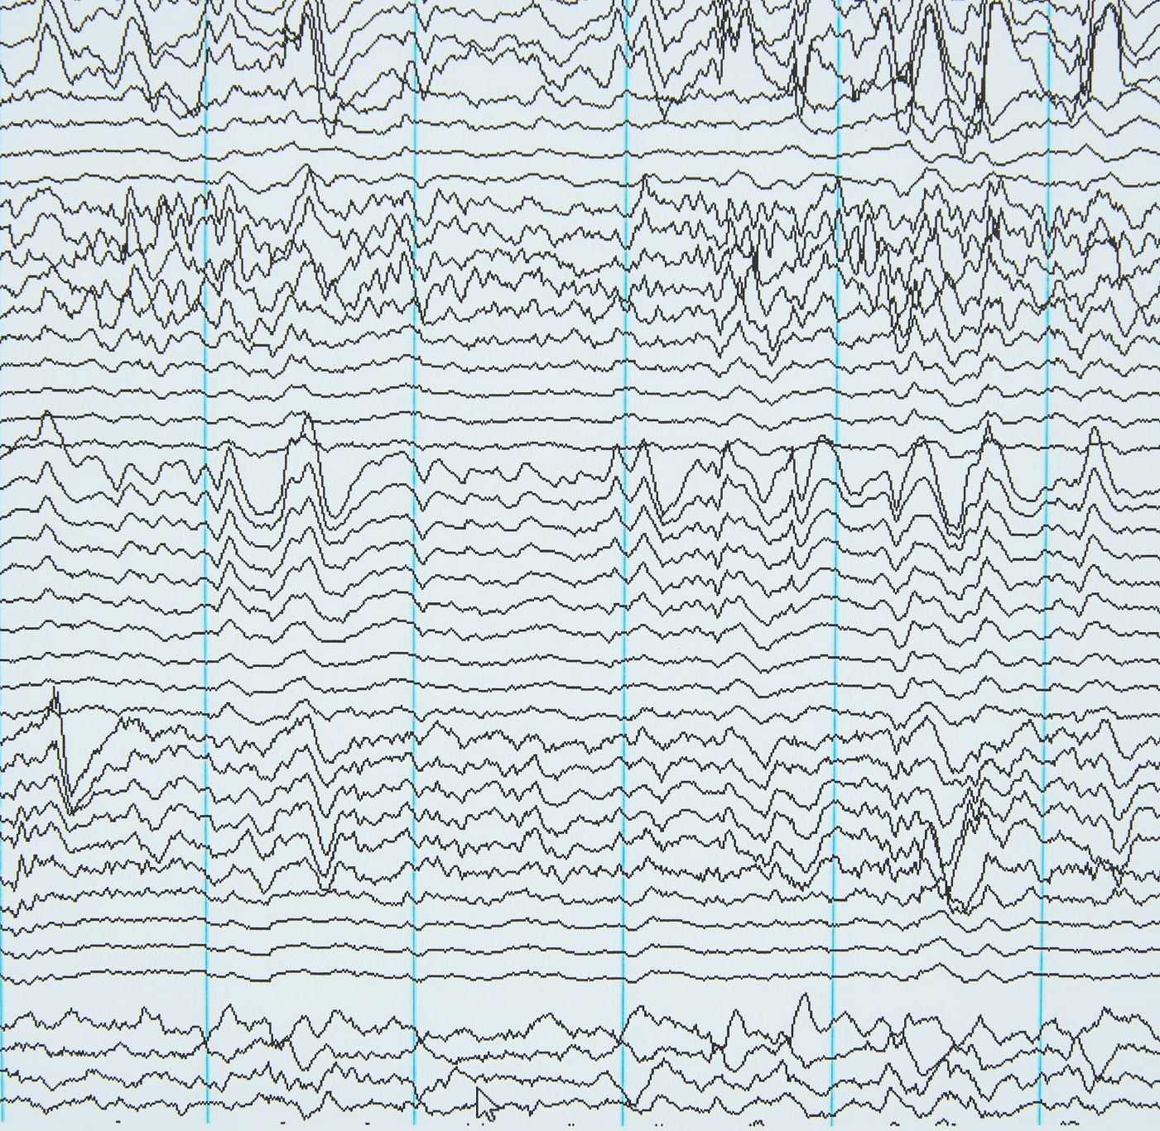
MINE (Maximal Information-based Nonparametric Exploration)
MINE is a statistical framework or a family of methods designed to discover and characterize relationships between variables, especially in high-dimensional data (lots of variables). It’s “nonparametric,” meaning it doesn’t assume any particular type of relationship (like linear or exponential) between the variables beforehand. This is a key advantage because real-world relationships are often complex and not easily captured by simple models. Instead of fitting specific models, MINE explores the data to find the best possible description of the relationship. MIC is one of the key statistics produced by MINE.

Slide 4

MIC (Maximal Information Coefficient)
MIC is a specific statistic produced by the MINE framework. It’s a measure of the strength of association between two variables and also:
Non-parametric: Like MINE, MIC doesn’t assume any specific type of relationship (linear, non-linear, etc.). It can detect a wide variety of relationships.
Scale-invariant: The value of MIC doesn’t change if you change the units or scale of your variables.
Interpretable: In the case of functional relationships (where one variable can be expressed as a function of the other), the MIC score is approximately equal to R-squared (R²), a familiar measure of how well a regression line fits the data. This provides a useful benchmark.
So, basically MINE is the overall framework, while MIC is a specific, powerful tool within that framework used to quantify the strength of association between two variables regardless of the nature of the relationship.

Slide 5
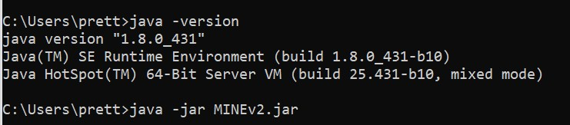
Configuring JAVA
To run MINE in Java the Java needs to be configured. So first, making sure Java is installed. Then downloading MINEv2.jar and opening a command prompt.

Slide 6
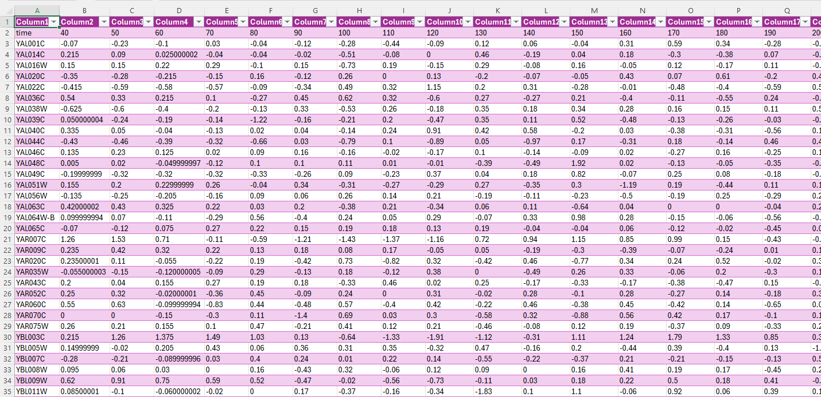
Dataset “Spellman.csv”
- the CDC15 yeast gene expression data set of Spellman et al.

Slide 7
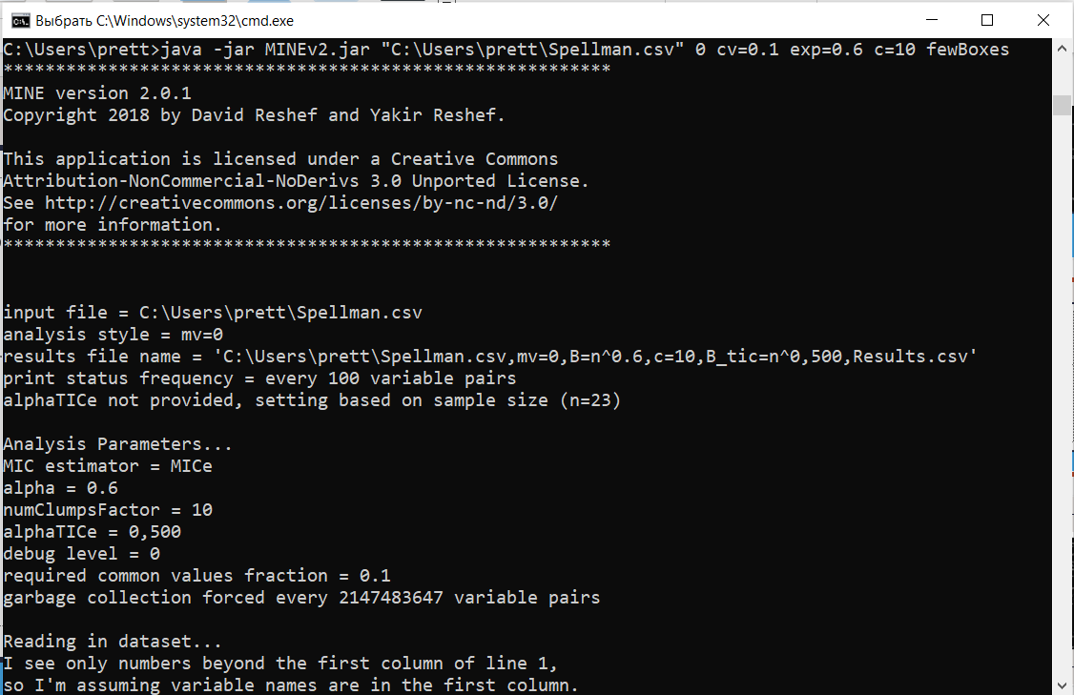
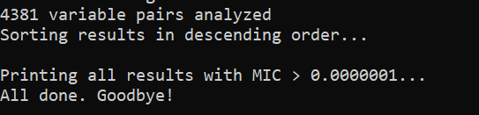
Running the code

Slide 8
Input explanation
I executed this line in terminal “java -jar MINEv2.jar “path to Spellman.csv" 0 cv=0.1 exp=0.6 c=10 fewBoxes”, with this parameters:
mv=0, meaning multivariate analysis is not being performed in this instance - it’s pairwise;
cv=0.1: This sets the required common values fraction to 0.1. This means that MINE will only consider variable pairs that share at least 10% of their values (to avoid spurious correlations);
exp=0.6: This sets the exponent used in calculating the number of bins (B) for the estimation of Mutual Information (B = n^0.6, where n is the number of data points). A smaller exponent leads to fewer bins. This parameter balances resolution and computational cost.
c=10: This sets the numClumpsFactor to 10, which controls the complexity of the estimation of Mutual Information. It is related to the number of clusters used. Larger values can lead to more accurate but slower computations.
fewBoxes: This is an additional parameter that restricts the number of bins used for the calculation which will lead to a faster estimation of the mutual information.

Slide 9
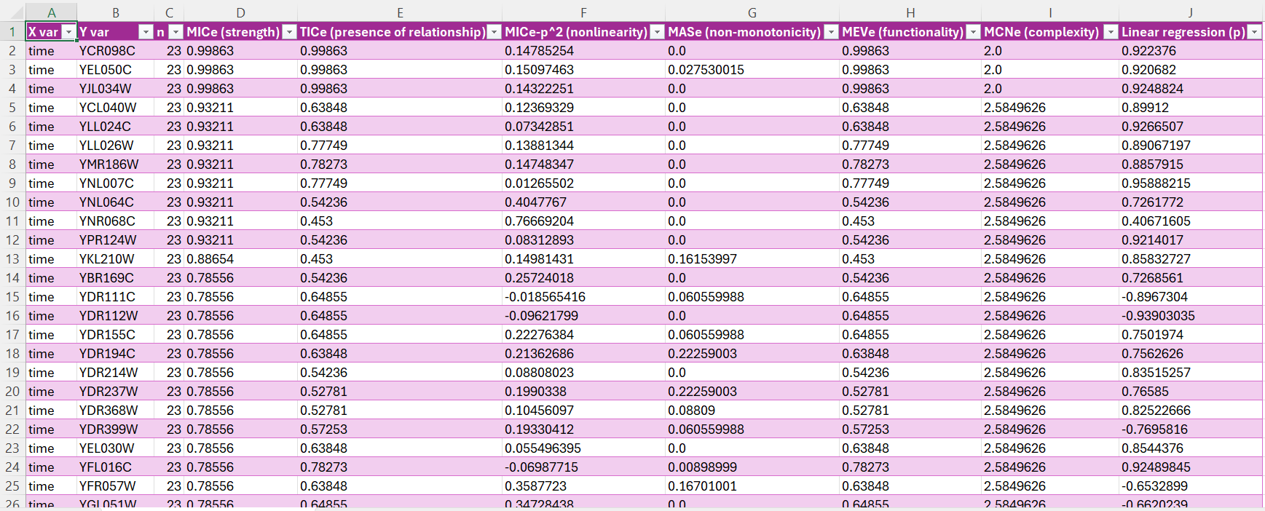
“Spellman.csv, mv=0,B=n^0.6,c=10,B_tic=n^0,500,Results.csv”

Slide 10
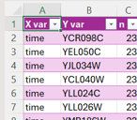
Results explanation
This table shows the results of a MINE analysis, providing various metrics to characterize the relationships between the “time” variable and other variables.
X var: This column consistently shows “time,” indicating that this is the reference variable against which all other variables are compared.
Y var: This column lists the names of the other variables in the dataset (e.g., YCR098C, YEL050C, etc.). These are gene identifiers.
n: This column shows the sample size, which is 23 for all rows. This means the analysis was performed on 23 data points (observations).

Slide 11
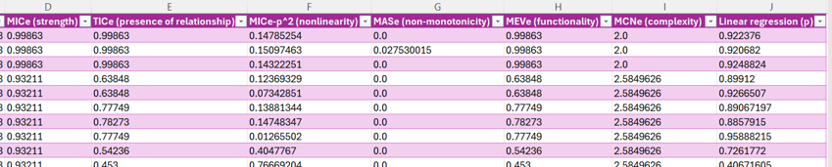
Results explanation
MICe (strength): This is the Maximal Information Coefficient (MICe). It’s a measure of the strength of the association between the “time” variable and the Y var. It ranges from 0 (no association) to 1 (perfect association).
TICe (presence of relationship): This is the “Threshold Information Coefficient” (TICe). It’s a p-value that assesses the statistical significance of the relationship detected by MICe. This indicates the probability of observing such a strong association by chance alone if no real relationship exists.
MICe-p^2 (nonlinearity): This metric appears to quantify the nonlinearity of the relationship. A high positive value suggests a highly nonlinear relationship, while a value near zero suggests a linear or nearly linear relationship. Negative values might indicate a weak or inverted relationship.

Slide 12
Results explanation
MASe (non-monotonicity): This measures the degree of non-monotonicity in the relationship. A monotonic relationship is one where as one variable increases, the other either consistently increases or consistently decreases.
MEVe (functionality): This assesses the functionality of the relationship. A high value means that the relationship can be well-approximated by a function.
MCNe (complexity): This might represent the complexity of the relationship as estimated by MINE.
Linear regression (p): This is the p-value from a linear regression model fitted to the data. This represents the statistical significance of a linear relationship between “time” and the Y var.

Slide 13
Conclusion
The analysis of the provided code and its output reveals a comprehensive investigation into the relationships between a time variable and many other variables, representing gene expression levels over time.
The use of the MINE algorithm, along with its associated metrics (MICe, TICe, MASe, MEVe), allowed for the detection of both linear and non-linear relationships, surpassing the limitations of traditional linear regression approaches.
The results, displayed in the detailed table, demonstrate the presence of several strong and statistically significant associations between the time variable and numerous genes. The high MICe values paired with low TICe values strongly indicate the existence of true relationships, not just random chance. The additional metrics provide valuable insights into the nature of these associations, revealing varying degrees of nonlinearity, monotonicity, and functional complexity. Although the consistent value in the MCNe column suggests a limitation in its informative power for this dataset.
Overall, this analysis successfully identifies and characterizes a rich set of dynamic relationships within the dataset, providing a valuable resource for further biological interpretation and investigation.

Slide 14

References
https://www.exploredata.net/Downloads/Gene-Expression-Data-Set - dataset
https://lexue.bit.edu.cn/pluginfile.php/690907/mod_assign/introattachment/0/Reshef.SOM.v2.pdf?forcedownload=1 – “Detecting Novel Associations in Large Data Sets”, David N. Reshef,* Yakir A. Reshef,* Hilary K. Finucane, Sharon R. Grossman, Gilean McVean, Peter J. Turnbaugh, Eric S. Lander, Michael Mitzenmacher, Pardis C. Sabeti

